Slide 1

STACK OVERFLOW
DEVELOPER SURVEY 2019
Harsh Sharma
September 03 2023

Slide 2

OUTLINE
Executive Summary
Introduction
Meth ology
Results
Visualization – Charts
Dashboard
Discussion
Findings & Implications
Conclusion
Appendix
o
d

Slide 3

EXECUTIVE SUMMARY
Data contextualization and analysis goal.
Methodology description.
Data gathering.
Data analysis.
Data visualizations.
Results presentation supported with graphs and trends.
Discussion of overall findings and implications regarding
the results previously exposed.
Final conclusions of the carried out research.

Slide 4

INTRODUCTION
Analyze technology trend in software and web development among developers around the world
Purpose of this Analysis
Identify the top programming languages, database, platform and web frame skills in demand
Identify skill requirements for future
Identify human resource gap in the industry
Audience for this Presentation
Programmers
IT industry leaders
Computer science students

Slide 5

METHODOLOGY
Collect survey data & explore its content
Web Scraping
APIs.
Request library.
Data Wrangling
Exploratory data analysis
Analyzing data distribution.
Handling outliers.
Correlations.
Data Visualization
Highlight distribution of data, relationships, the composition and comparison of data.
Dashboards

Slide 6

RESULTS

Slide 7
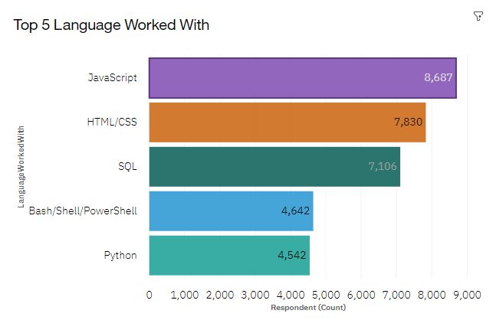
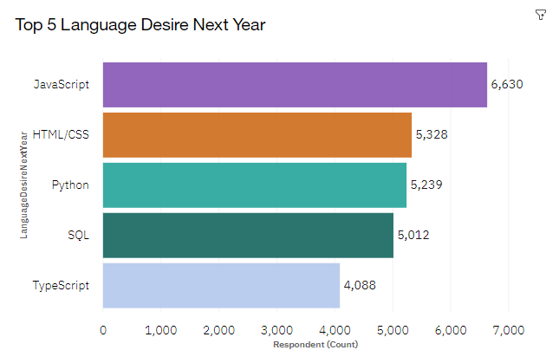
PROGRAMMING LANGUAGE TRENDS
Current Year Next Year

Slide 8
PROGRAMMING LANGUAGE TRENDS - FINDINGS & IMPLICATIONS
Findings
JavaScript is top trending language in the world
Python and TypeScript are becoming more and more popular
HTML/CSS and SQL still has great portion in language usage trend
Implications
Web developments and Web developers are still in high demands
JavaScript and TypeScript are crucial to learn for developers
Python is the new trending language, especially popular in AI fields

Slide 9
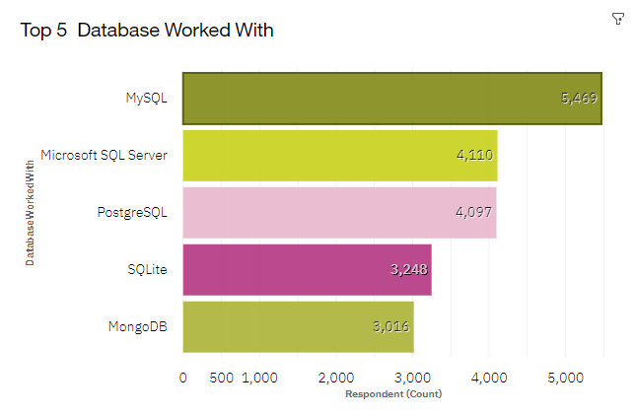
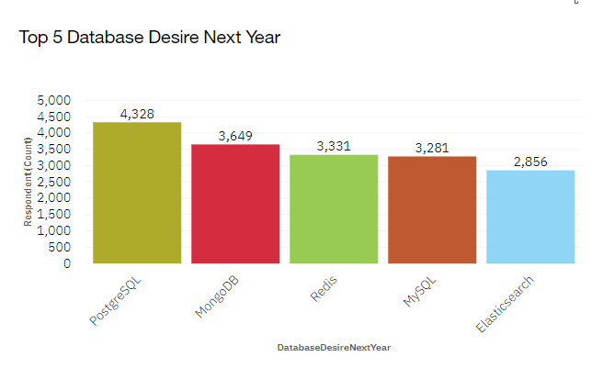
DATABASE TRENDS
Current Year
Next Year

Slide 10
DATABASE TRENDS - FINDINGS & IMPLICATIONS
Findings
MySQL is the most popular database
There are still a lot of companies using Microsoft SQL Server
MongoDB and Redis are the most favorable NoSQL database
Implications
Open-source databases like MySQL are still preferable
Software development and Big Data technology still requires SQL
NoSQL databases will make an impact for relational databases

Slide 11
DASHBOARD
The permanent link of the read-only view of the Cognos dashboard:
https://dataplatform.cloud.ibm.com/dashboards/b0e09f5b-d11d-4dec-9b36-63b5ba755dd5/view/5c24c316048a0dc04cefd0e4079f2f032e65225fe6bbd755d5d07b490c602097f06a1b96c879495c88130166a6e5145d98

Slide 12
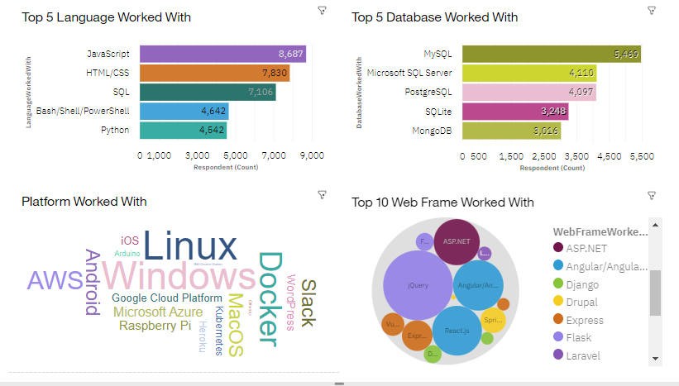
CURRENT TECHNOLOGY USAGE

Slide 13
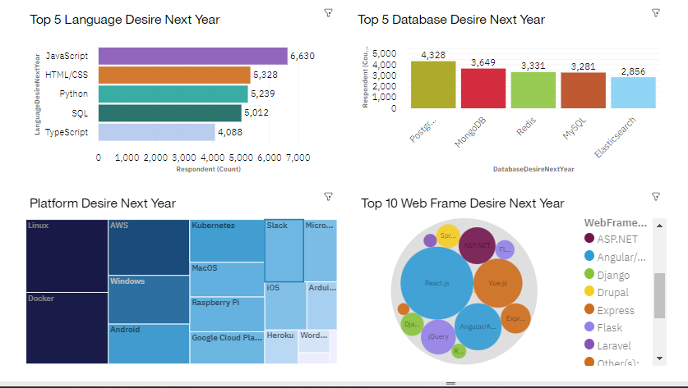
FUTURE TECHNOLOGY TREND

Slide 14
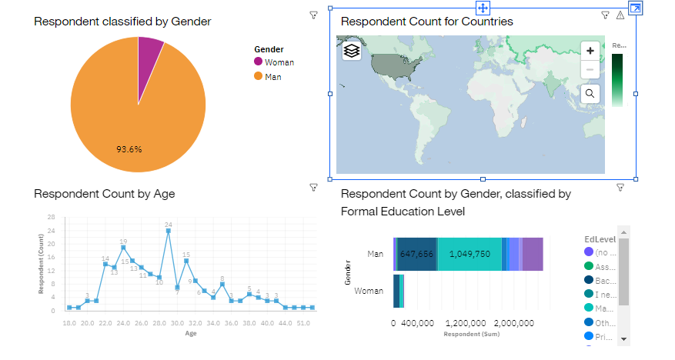
DEMOGRAPHICS

Slide 15
DISCUSSION

Slide 16
OVERALL FINDINGS & IMPLICATIONS
Findings Implications
JavaScript widely used and TypeScript getting popular.
Over 90% young male developers.
Developers mostly located in developed countries.
JavaScript and TypeScript web frames gaining followers.
Global polarization of developers location and gender.
Young developers without postgrad studies on its majority.

Slide 17

CONCLUSION
A good idea of popularity trends of different tools, platforms and languages can be obtained.
Due to high demand in the field, competition is getting high and there is a need to quick adaptation to change.
Artificial Intelligence and the like are new area impacting the technology field and are probably skills ones must seek to acquire.
There is a job to be done to spread accessibility of this labor market to countries in development.

Slide 18

APPENDIX

Slide 19
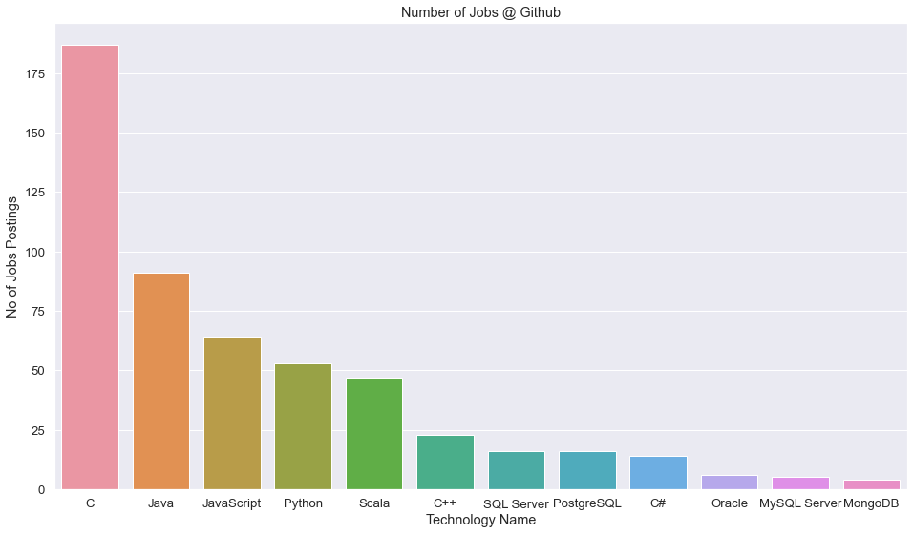
GITHUB JOB POSTINGS

Slide 20
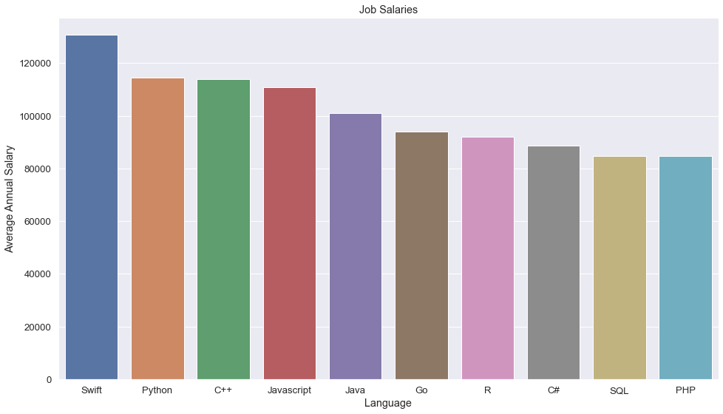
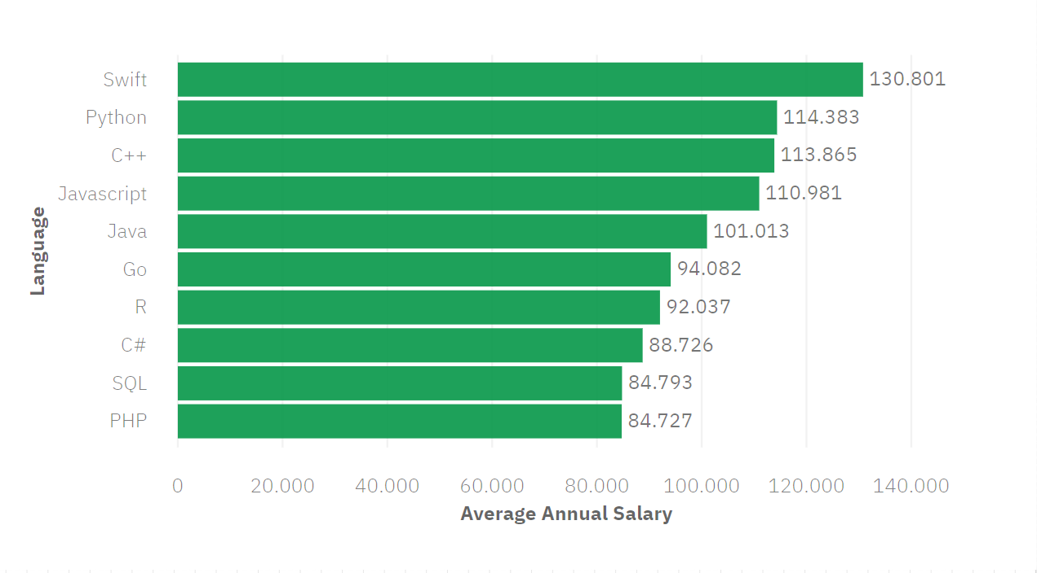
POPULAR LANGUAGES

